Slide 1
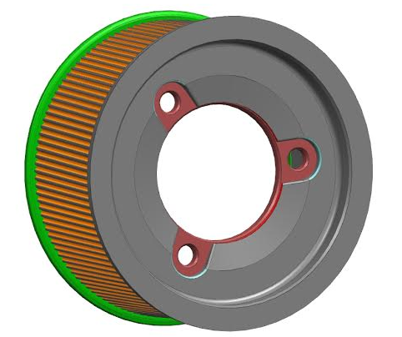
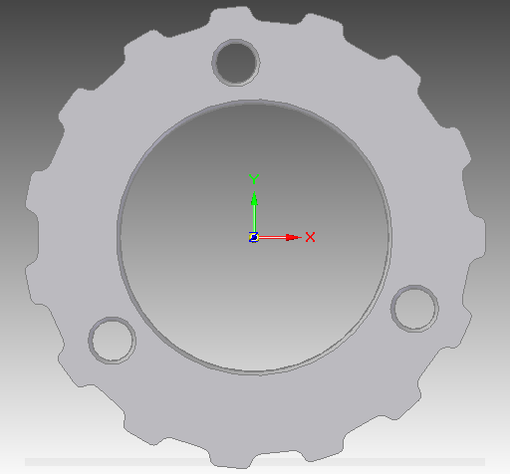
Over-molded Plastic Pulley Development
Last updated: 02SE15
Replace bolt-on metal pulley with plastic over-molded design
Led by Ford P552/S550
Motivation: Cost optimization
Deliverables
Baseline against current design
Design strategy for use in applications
Timing
Baseline results expected end of Q3
Design strategy expected Q1 2016
Team Members/Customers
Team: Emily Stilwell / Kevin McClendon
Customers: REPS application teams

Slide 2
Over-molded Plastic Pulley Development
Last updated: 02SE15
Status Update:
Component durability testing in-process
Included in P552/S550 LOAA Phase 2 validation gears
$2.30 piece price savings P552/S550
Recommended for pursuits with design rules against press fit pulleys
Challenges:
Supplier development of over-molding process
Assist mech availability
Durability stand availability
Next Actions:
Complete baseline testing
System level DV testing
Design strategy for retrofitting and new programs

